Slide 1

數位語音處理概論
Introduction to Digital Speech Processing
7.0 Speech Signal and Front-end Processing
References for 7.0 1. 3.3, 3.4 of Becchetti 2. 9.3 of Huang
授課教師：國立臺灣大學 電機工程學系 李琳山 教授
【本著作除另有註明外，採取創用CC「姓名標示－非商業性－相同方式分享」臺灣3.0版授權釋出】

Slide 2
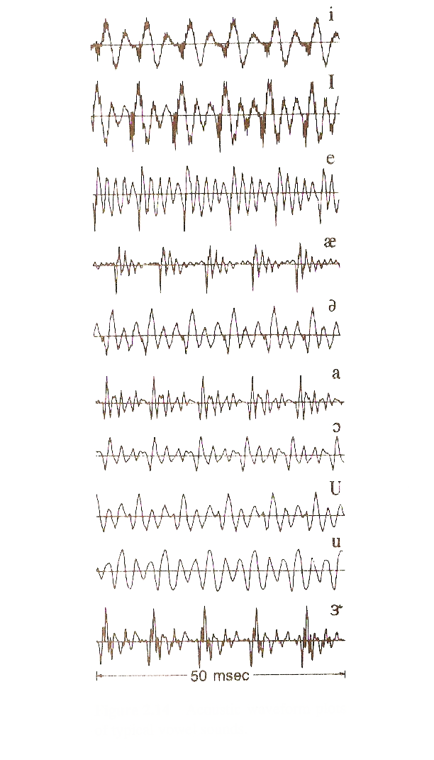
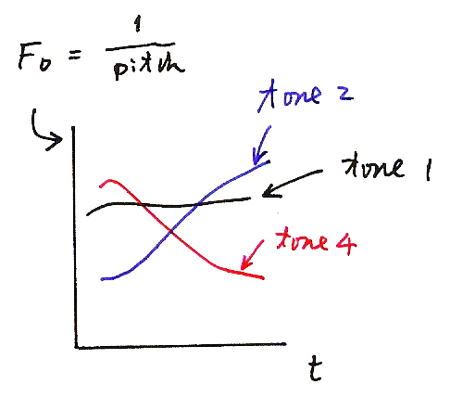
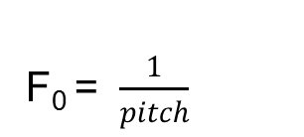
Waveform plots of typical vowel sounds - Voiced（濁音）
(音高)
tone 2
tone 1
tone 4
t

Slide 3
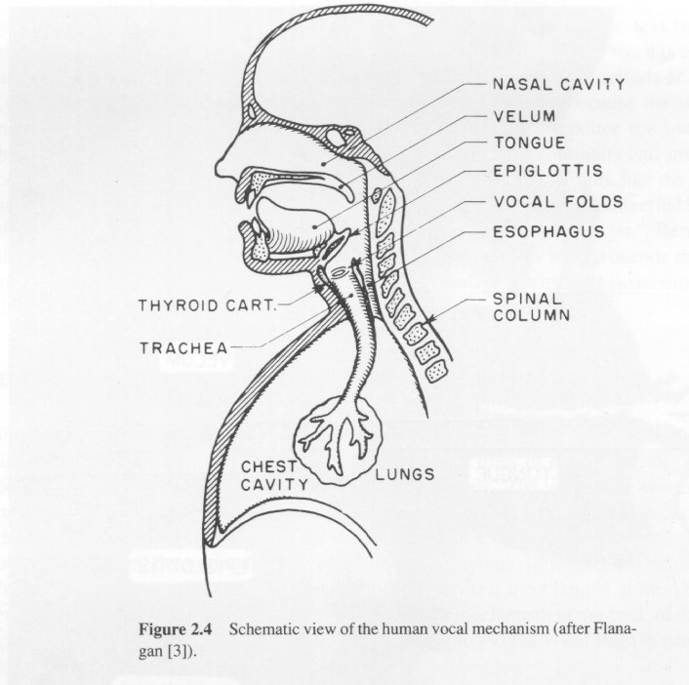
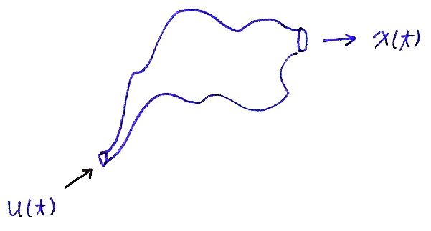
Speech Production and Source Model
Human vocal mechanism
Speech Source Model
Vocal
tract
excitation
x(t)
u(t)

Slide 4
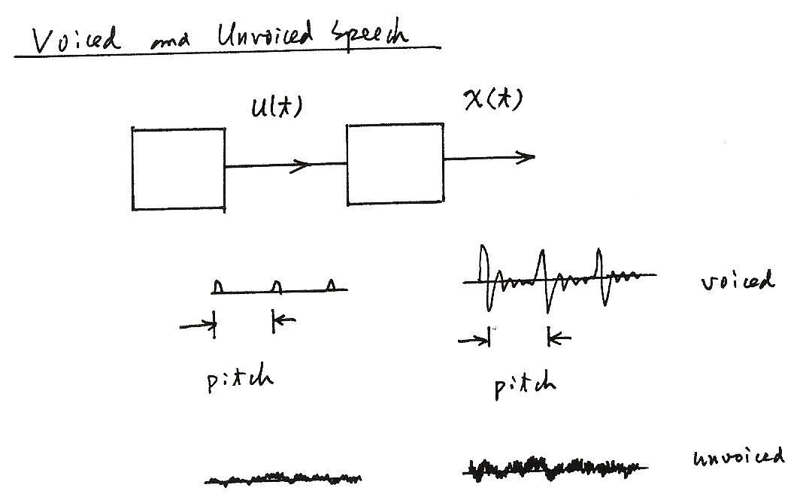
Voiced and Unvoiced Speech
u(t)
x(t)
voiced
pitch
pitch
unvoiced

Slide 5
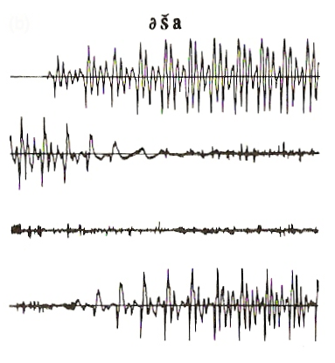
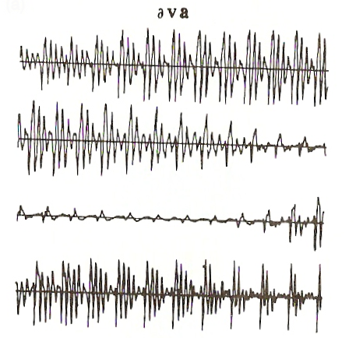
Waveform plots of typical consonant sounds
Unvoiced （清音）
Voiced （濁音）

Slide 6
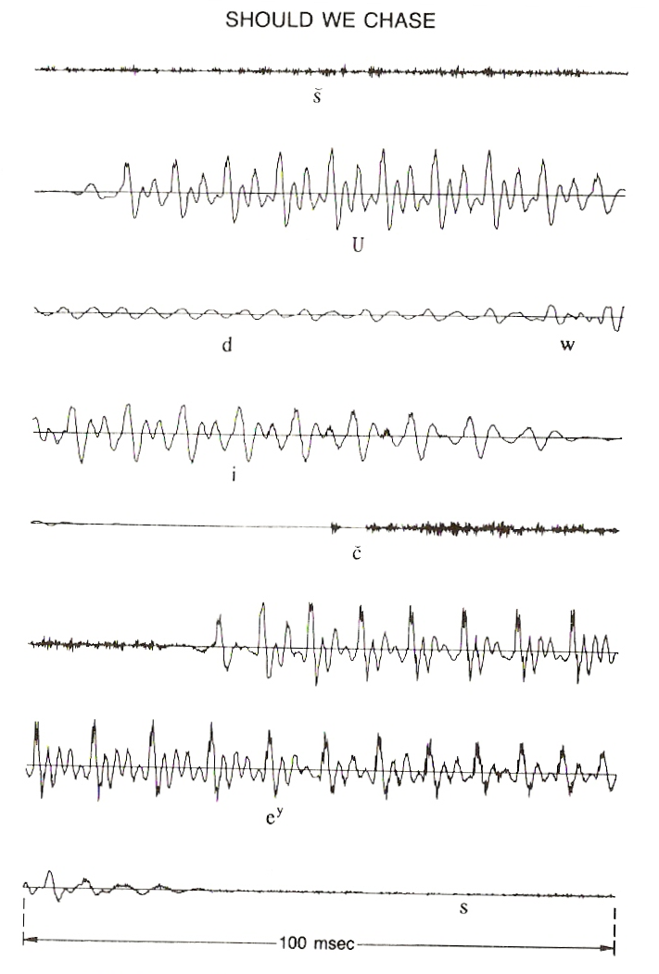
Waveform plot of a sentence

Slide 7
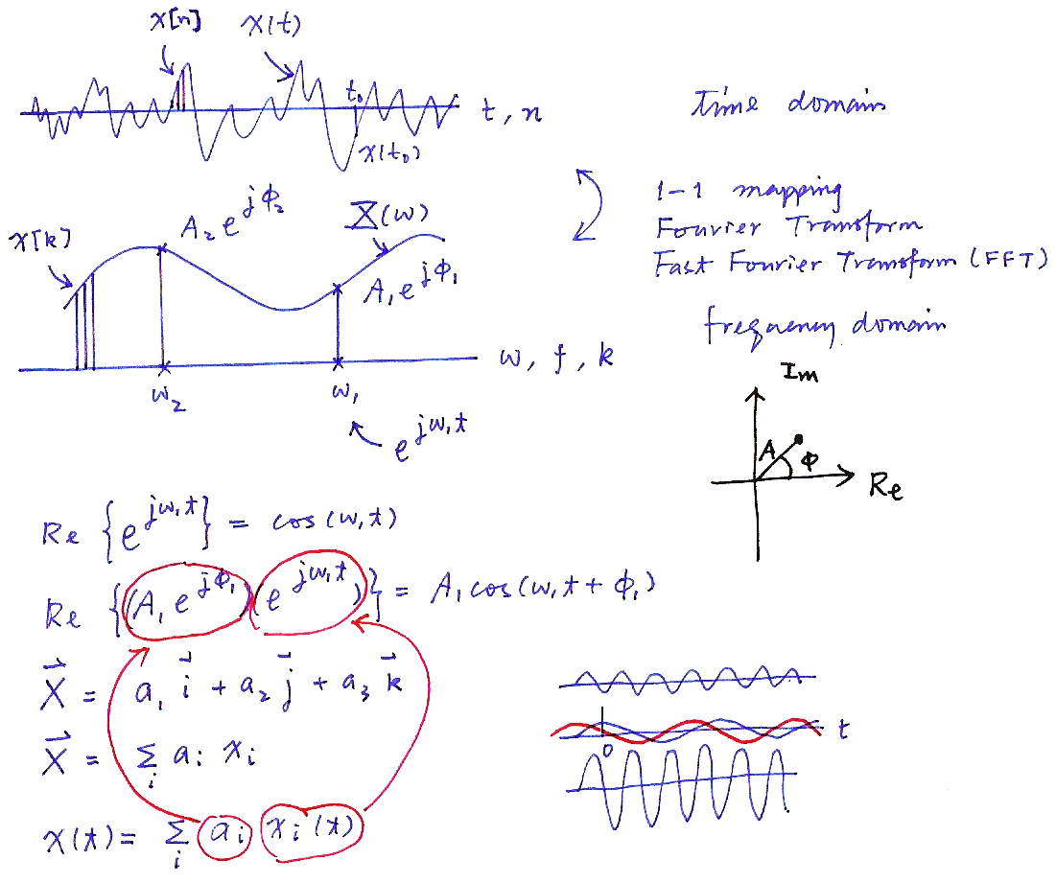
Time and Frequency Domains (P.12 of 2.0)
time domain
1-1 mapping
Fourier Transform
Fast Fourier Transform (FFT)
frequency domain
X[k]
$$R_{e}\left\{e^{jω_{1}t}\right\}=\cos{(ω_{1}t)}$$
$$R_{e}\left\{(A_{1} e^{jφ_{1}}) (e^{jω_{1}t}) \right\}=A_{1}cos{(ω_{1}t+φ_{1})}$$
$$\vec{X}= a_{1}\vec{i }+a_{2}\vec{j }+a_{3}\vec{k}$$
$$\vec{X}= \sum_{i}{a_{i }x_{i}}$$
$$x\left(t\right)=\sum_{i}{a_{i} x_{i}}(t)$$

Slide 8
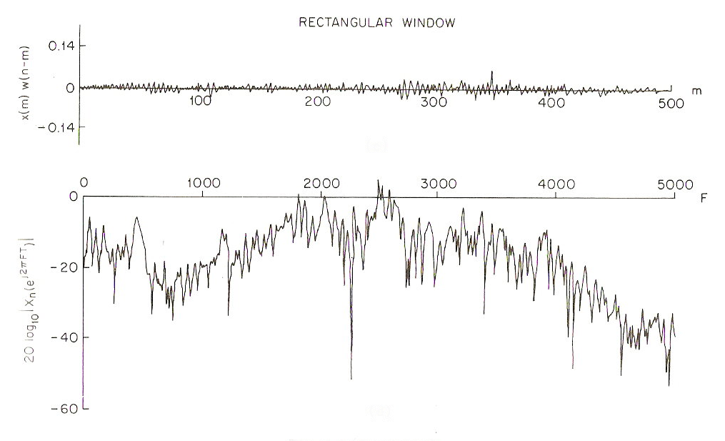
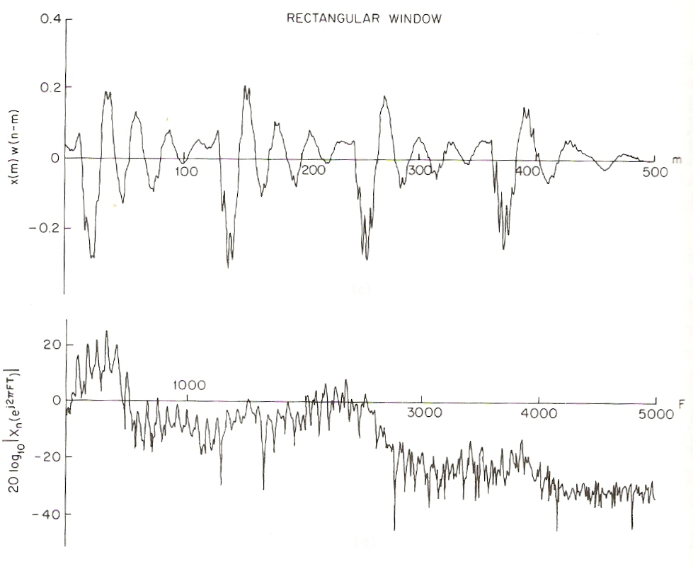
Frequency domain spectra of speech signals
Voiced
Unvoiced

Slide 9
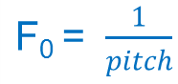
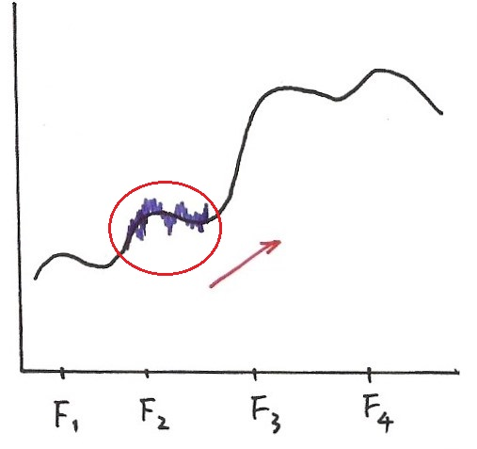
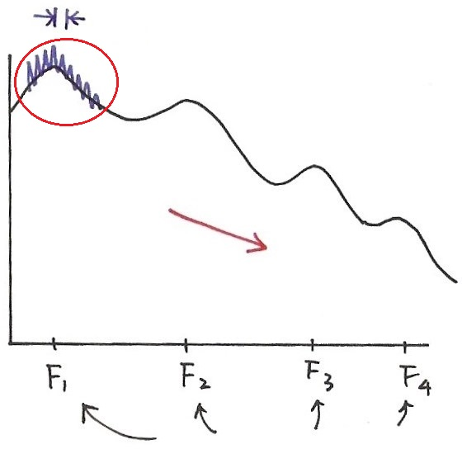
Frequency Domain
Voiced
Unvoiced
Formant
Structure
Formant
Structure
excitation
excitation
formant frequencies
formant frequencies

Slide 10
Input/Output Relationship for Time/Frequency Domains
formant
structure
excitation
F
F
F
time domain: convolution
frequency domain: product
$g\left(t\right), G(ω)$: Formant structure: differences between
phonemes
$u\left(t\right), U(ω)$: excitation

Slide 11
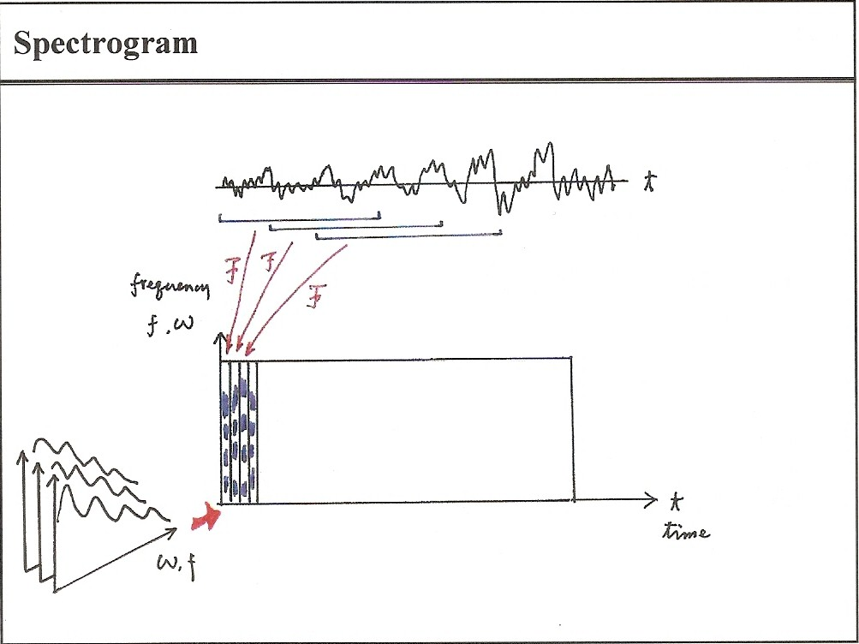
Spectrogram

Slide 12
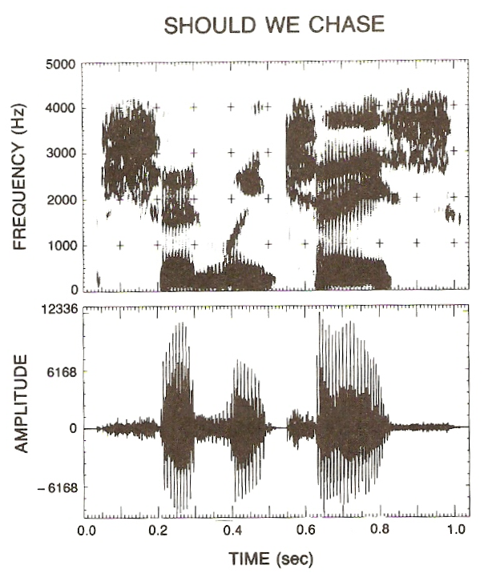
Spectrogram

Slide 13
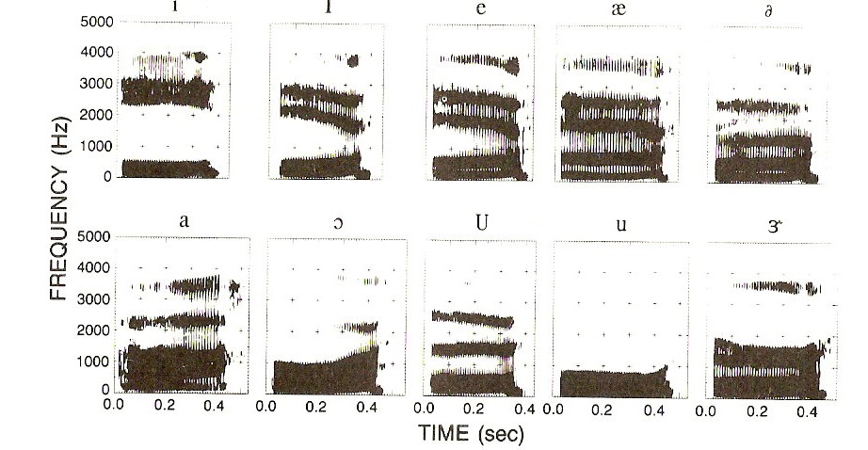
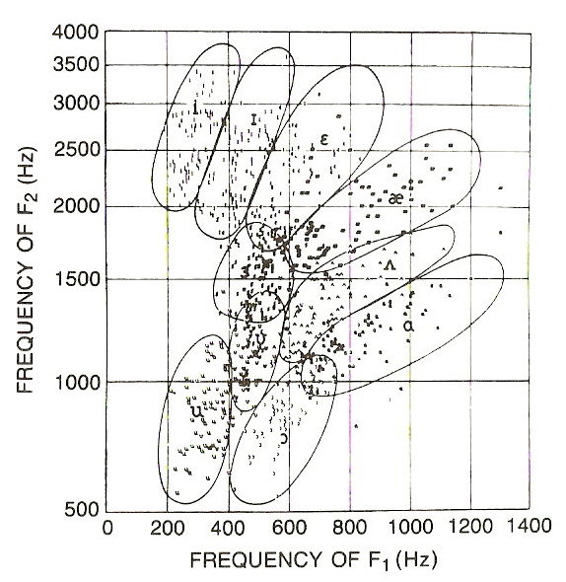
Formant Frequencies

Slide 14
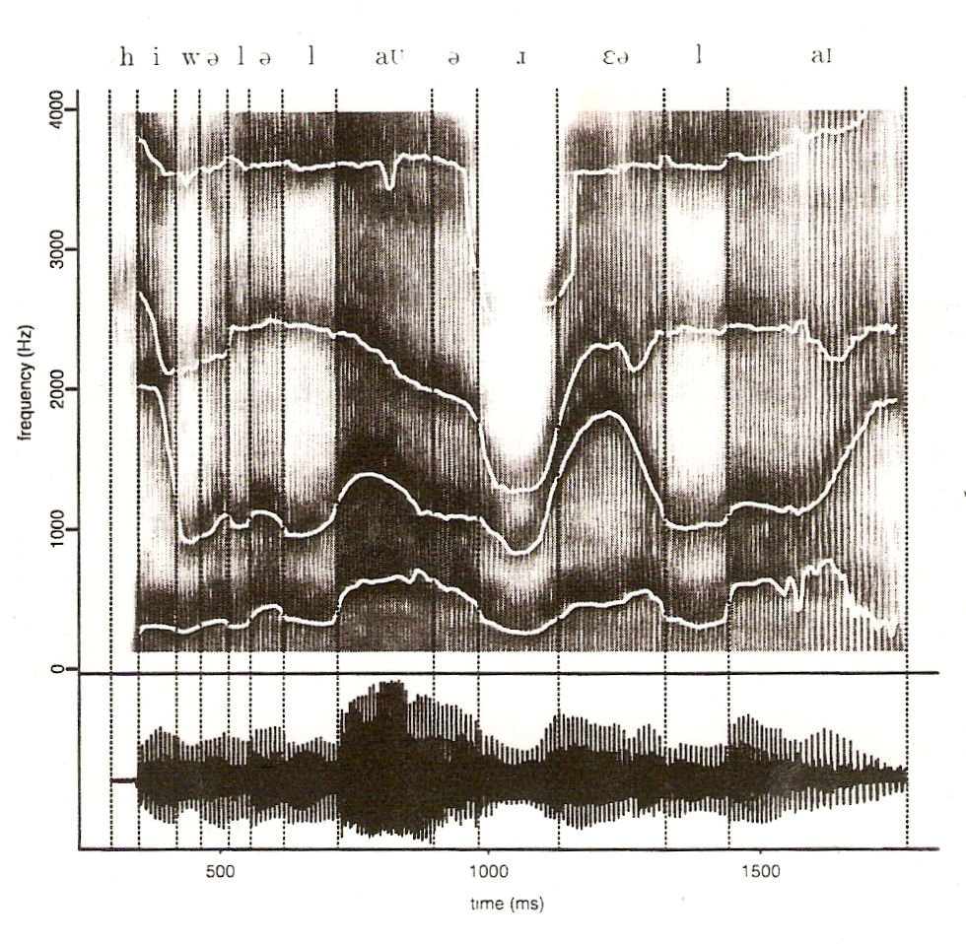
Formant frequency contours
He will allow a rare lie.
Reference: 6.1 of Huang, or 2.2, 2.3 of Rabiner and Juang

Slide 15
Speech Signals
Voiced/unvoiced 濁音、清音
Pitch/tone 音高、聲調
Vocal tract 聲道
Frequency domain/formant frequency
Spectrogram representation
Speech Source Model
Ex
G(ω),G(z), g[n]
u[n]
x[n]
Excitation Generator
Vocal Tract Model
U (ω)
U (z)
x[n]=u[n]∗g[n]
X(ω)=U(ω)G(ω)
X(z)=U(z)G(z)
parameters
parameters
digitization and transmission of the parameters will be adequate
at receiver the parameters can produce x[n] with the model
much less parameters with much slower variation in time lead to much less bits required
the key for low bit rate speech coding

Slide 16
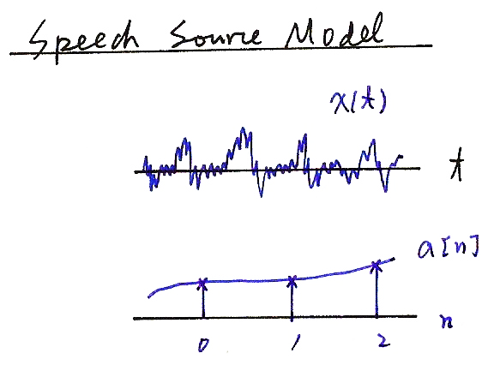
Speech Source Model
x(t)
t
a[n]
n

Slide 17
Speech Source Model
Sophisticated model for speech production
Simplified model for speech production
Voiced
Pitch period, N
G
Periodic Impulse
Train Generator
G(z)
Glottal
filter
V
H(z)
Vocal Tract
Filter
R(z)
Lip
Radiation
Filter
x(n)
Speech
Signal
Uncorrelated
Noise
Generator
U
G
Unvoiced
Pitch period, N
Voiced
Periodic Impulse
Train Generator
Voiced/unvoiced
switch
V
Combined
Filter
x(n)
Speech
Signal
Random
Sequence
Generator
U
G
Unvoiced

Slide 18
Simplified Speech Source Model
unvoiced
voiced
G(z), G(ω), g[n]
random
sequence
generator
G(z) =
x[n]
×
u[n]
1
1− ∑ a_{k}z^{-k}
P
k = 1
periodic pulse train
generator
G
v/u
Vocal Tract Model
N
Excitation
Excitation parameters
v/u : voiced/ unvoiced
N : pitch for voiced
G : signal gain
→ excitation signal u[n]
Vocal Tract parameters
{a_{k}} : LPC coefficients
→formant structure of speech signals
A good approximation, though not
precise enough
Reference: 3.3.1-3.3.6 of Rabiner and Juang, or 6.3 of Huang

Slide 19

Speech Source Model
1
$$G\left(z\right)=$$
u[n]
x[n]
$$1− \sum_{k=1}^{P}{a_{k}}z^{−k}$$
$$x\left[n\right]−\sum_{k=1}^{P}{a_{k}}x\left[n−k\right]=u[n]$$

Slide 20
Feature Extraction - MFCC
Mel-Frequency Cepstral Coefficients (MFCC)
Most widely used in the speech recognition
Has generally obtained a better accuracy at relatively low computational complexity
The process of MFCC extraction :
Speech signal
x_{t}(n)
X_{t}(k)
Mel filter-bank
Pre-emphasis
DFT
x(n)
x’(n)
Window
Y_{t}(m)
energy
Log(| |²)
e_{t}
derivatives
y_{t} (j)
Y_{t}’(m)
IDFT
MFCC

Slide 21
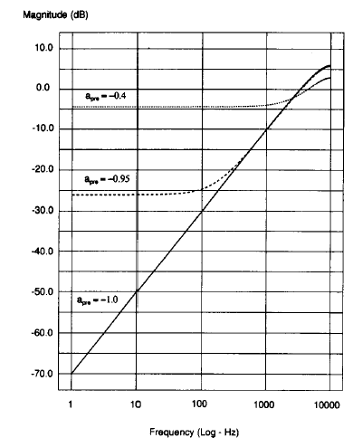
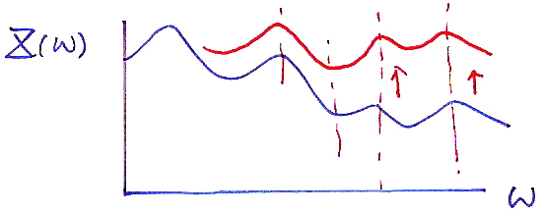
Pre-emphasis
The process of Pre-emphasis :
a high-pass filter
Speech signal x(n)
x’(n)=x(n)-ax(n-1)
H(z)=1-a • z⁻¹ 0<a≤1

Slide 22
Why pre-emphasis?
Reason :
Voiced sections of the speech signal naturally have a negative spectral slope (attenuation) of approximately 20 dB per decade due to the physiological characteristics of the speech production system
High frequency formants have small amplitude with respect to low frequency formants. A pre-emphasis of high frequencies is therefore helpful to obtain similar amplitude for all formants

Slide 23
Why Windowing?
Why dividing the speech signal into successive and overlapping frames?
Voice signals change their characteristics from time to time. The characteristics remain unchanged only in short time intervals (short-time stationary, short-time Fourier transform)
Frames
Frame Length : the length of time over which a set of parameters can be obtained and is valid. Frame length ranges between 20 ~ 10 ms
Frame Shift: the length of time between successive parameter calculations
Frame Rate: number of frames per second

Slide 24
Waveform plot of a sentence

Slide 25
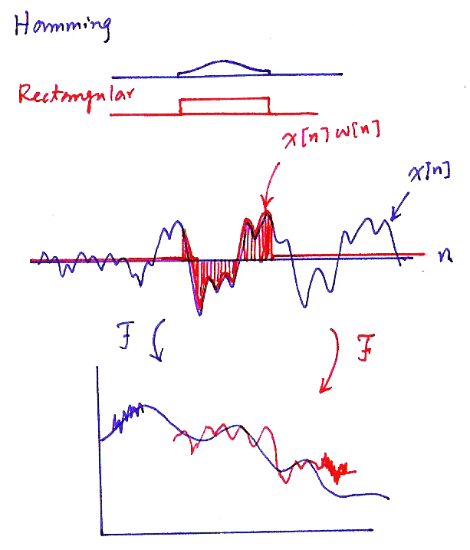
Hamming
Rectangular
x[n]w[n]
x[n]
F
F

Slide 26
Effect of Windowing (1)
Windowing :
x_{t}(n)=w(n)•x’(n), w(n): the shape of the window
(product in time domain)
X_{t}(ω)=W(ω)*X’(ω), *: convolution
(convolution in frequency domain)
Rectangular window (w(n)=1 for 0 ≤ n ≤ L-1):
simply extract a segment of the signal
whose frequency response has high side lobes
Main lobe : spreads out the narrow band power
of the signal (that around the formant
frequency) in a wider frequency range, and thus reduces the local frequency resolution in formant allocation
Side lobe : swap energy from different and distant frequencies
Rectangular
Hamming
(dB)
π
ω

Slide 27
Input/Output Relationship for Time/Frequency Domains (P.10 of 7.0)
formant
structure
excitation
F
F
F
time domain: convolution
frequency domain: product
$g\left(t\right), G(ω)$: Formant structure: differences between
phonemes
$u\left(t\right), U(ω)$: excitation

Slide 28
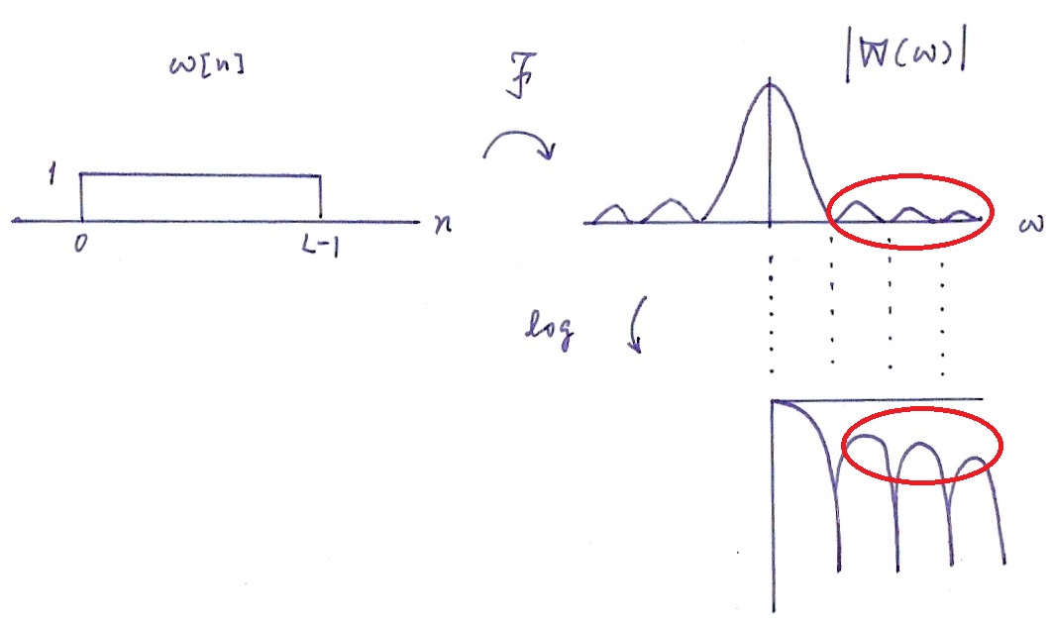
Windowing
side lobes
main lobe
Main lobe : spreads out the narrow band power of the signal (that around the formant frequency) in a wider frequency range, and thus reduces the local frequency resolution in formant allocation
Side lobe : swap energy from different and distant frequencies

Slide 29
Effect of Windowing (2)
Windowing (Cont.):
For a designed window, we wish that
the main lobe is as narrow as possible
the side lobe is as low as possible
However, it is impossible to achieve both simultaneously. Some trade-off is needed
The most widely used window shape is the Hamming window

Slide 30
DFT and Mel-filter-bank Processing
For each frame of signal (L points, e.g., L=512),
the Discrete Fourier Transform (DFT) is first performed to obtain its spectrum (L points, for example L=512)
The bank of filters based on Mel scale is then applied, and each filter output is the sum of its filtered spectral components (M filters, and thus M outputs, for example M=24)
sum
Y_{t}(0)
ω
Time domain signal
spectrum
t
DFT
ω
sum
Y_{t}(1)
ω
x_{t}(n)
X_{t}(k)
L
n = 0,1,....L-1
k = 0,1,.... -1
2
sum
Y_{t}(M-1)
ω

Slide 31
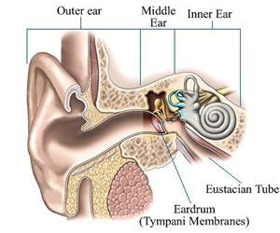
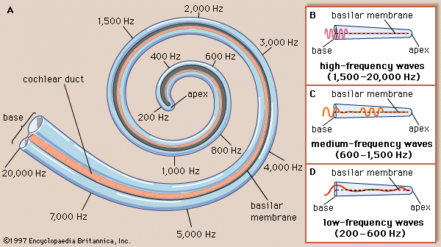
Peripheral Processing for Human Perception

Slide 32
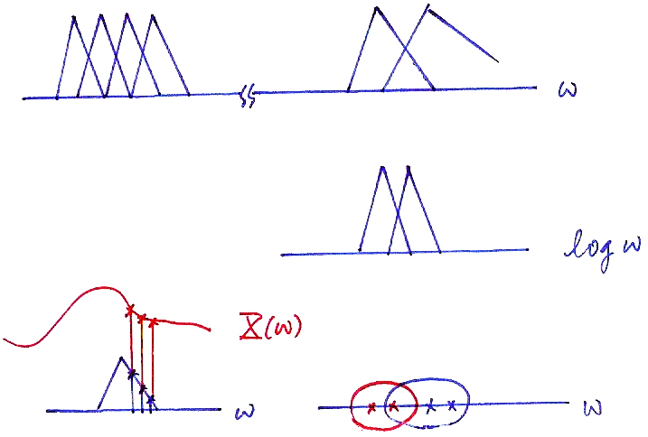
Mel-scale Filter Bank
$$ω$$
$$\log{ω}$$
$$X(ω)$$
$$ω$$
$$ω$$

Slide 33
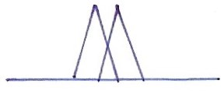
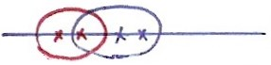
Why Filter-bank Processing?
The filter-bank processing simulates human ear perception
Frequencies of a complex sound within a certain frequency band cannot be individually identified.
When one of the components of this sound falls outside this frequency band, it can be individually distinguished.
This frequency band is referred to as the critical band.
These critical bands somehow overlap with each other.
The critical bands are roughly distributed linearly in the logarithm frequency scale (including the center frequencies and the bandwidths), specially at higher frequencies.
Human perception for pitch of signals is proportional to the logarithm of the frequencies (relative ratios between the frequencies)
$$ω$$
$$\log{ω}$$

Slide 34
Feature Extraction - MFCC
Mel-Frequency Cepstral Coefficients (MFCC)
Most widely used in the speech recognition
Has generally obtained a better accuracy at relatively low computational complexity
The process of MFCC extraction :
Speech signal
x_{t}(n)
X_{t}(k)
Mel filter-bank
Pre-emphasis
DFT
x(n)
x’(n)
Window
Y_{t}(m)
energy
Log(| |²)
e_{t}
derivatives
y_{t} (j)
Y_{t}’(m)
IDFT
MFCC

Slide 35
Logarithmic Operation and IDFT
The final process of MFCC evaluation : logarithm operation and IDFT
Mel-filter output Y_{t}(m)
Filter index(m)
0
M-1
Log(| |²)
Y’_{t}(m)
Filter index(m)
0
M-1
IDFT
y_{t}=CY’_{t}
MFCC vector y_{t}( j)
quefrency( j)
0
J-1

Slide 36
Why Log Energy Computation?
Using the magnitude (or energy) only
Phase information is not very helpful in speech recognition
Replacing the phase part of the original speech signal with continuous random phase usually won’t be perceived by human ears
Using the Logarithmic operation
Human perception sensitivity is proportional to signal energy in logarithmic scale (relative ratios between signal energy values)
The logarithm compresses larger values while expands smaller values, which is a characteristic of the human hearing system
The dynamic compression also makes feature extraction less sensitive to variations in signal dynamics
To make a convolved noisy process additive
Speech signal x(n), excitation u(n) and the impulse response of vocal tract g(n) x(n)=u(n)*g(n) ➔X(ω)=U(ω)G(ω) ➔ |X(ω)|=|U(ω)||G(ω)| ➔log|X(ω)|=log|U(ω)|+log|G(ω)|

Slide 37
Why Inverse DFT?
Final procedure for MFCC : performing the inverse DFT on the log-spectral power
Advantages :
Since the log-power spectrum is real and symmetric, the inverse DFT reduces to a Discrete Cosine Transform (DCT). The DCT has the property to produce highly uncorrelated features y_{t}
diagonal rather than full covariance matrices can be used in the Gaussian distributions in many cases
Easier to remove the interference of excitation on formant structures
the phoneme for a segment of speech signal is primarily based on the formant structure (or vocal tract shape)
on the frequency scale the formant structure changes slowly over frequency, while the excitation changes much faster

Slide 38
Speech Production and Source Model (P.3 of 7.0)
Human vocal mechanism
Speech Source Model
Vocal
tract
excitation
x(t)
u(t)

Slide 39
Voiced and Unvoiced Speech (P.4 of 7.0)
u(t)
x(t)
voiced
pitch
pitch
unvoiced

Slide 40
Frequency domain spectra of speech signals (P.8 of 7.0)
Voiced
Unvoiced

Slide 41
Frequency Domain (P.9 of 7.0)
Voiced
Unvoiced
Formant
Structure
Formant
Structure
excitation
excitation
formant frequencies
formant frequencies

Slide 42
Input/Output Relationship for Time/Frequency Domains (P.10 of 7.0)
formant
structure
excitation
F
F
F
time domain: convolution
frequency domain: product
$g\left(t\right), G(ω)$: Formant structure: differences between
phonemes
$u\left(t\right), U(ω)$: excitation

Slide 43
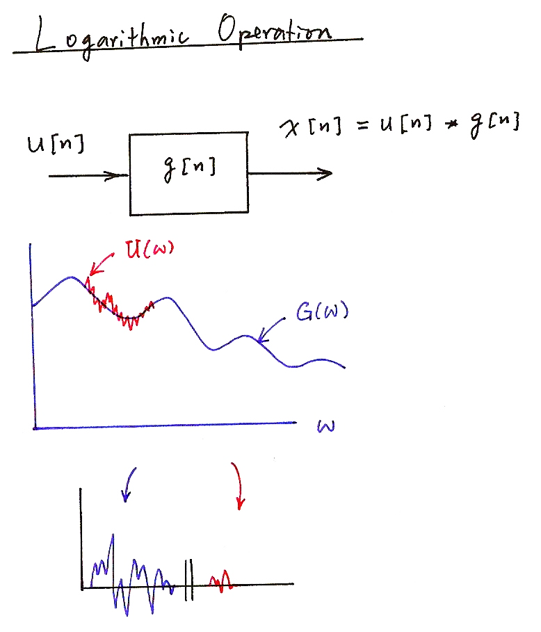
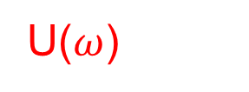
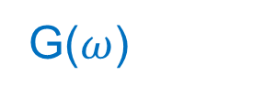

Logarithmic Operation
u[n]
x[n]= u[n]*g[n]
g[n]

Slide 44
Derivatives
Derivative operation : to obtain the change of the feature vectors with time
t-1 t t+1 t+2
quefrency(j)
MFCC stream y_{t}(j)
Frame index
quefrency(j)
ΔMFCC stream Δy_{t} (j)
Frame index
quefrency(j)
Δ² MFCC stream Δ² y_{t}(j)
Frame index

Slide 45
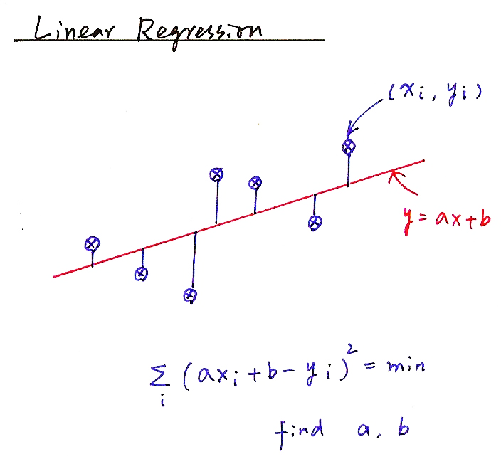
Linear Regression
(x_{i}, y_{i})
y=ax+b
find a, b

Slide 46
Why Delta Coefficients?
To capture the dynamic characters of the speech signal
Such information carries relevant information for speech recognition
The value of p should be properly chosen
The dynamic characters may not be properly extracted if p is too small
Too large P may imply frames too far away
To cancel the DC part (channel distortion or convolutional noise) of the MFCC features
Assume, for clean speech, an MFCC parameter stream for an utterance is {y(t-N), y(t-N+1),…....,y(t), y(t+1), y(t+2), ……},
y(t) is an MFCC parameter at time t, while after channel distortion, the MFCC stream becomes {y(t-N)+h, y(t-N+1)+h,…....,y(t)+h, y(t+1)+h, y(t+2)+h, ……} the channel effect h is eliminated in the delta (difference) coefficients

Slide 47
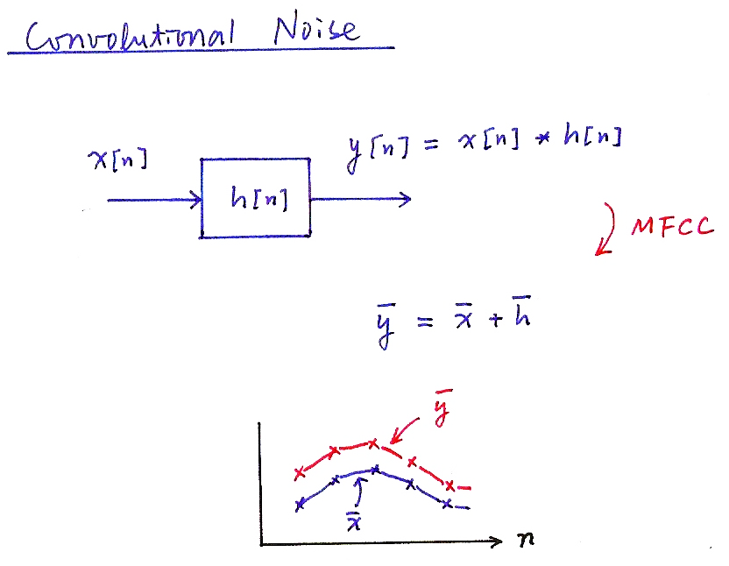
Convolutional Noise
y[n]= x[n]*h[n]
x[n]
h[n]
MFCC
y = x + h

Slide 48
End-point Detection
Push (and Hold) to Talk/Continuously Listening
Adaptive Energy Threshold
Low Rejection Rate
false acceptance may be rescued
Vocabulary Words Preceded and Followed by a Silence/Noise Model
Two-class Pattern Classifier
Gaussian density functions used to model the two classes
log-energy, delta log-energy as the feature parameters
dynamically adapted parameters
Speech
Silence/
Noise

Slide 49
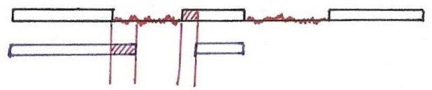
End-point Detection
silence
(noise)
speech
detected speech
segments
false acceptance
false rejection

Slide 50
與語音學、訊號波型、頻譜特性有關的網址
17. Three Tutorials on Voicing and Plosives http://homepage.ntu.edu.tw/~karchung/intro%20page%2017.htm 8. Fundamental frequency and harmonics http://homepage.ntu.edu.tw/~karchung/phonetics%20II%20page%20eight.htm 9. Vowels and Formants I: Resonance (with soda bottle demonstration) http://homepage.ntu.edu.tw/~karchung/Phonetics%20II%20page%20nine.htm 10. Vowels and Formants II (with duck call demonstration) http://homepage.ntu.edu.tw/~karchung/Phonetics%20II%20page%20ten.htm 12. Understanding Decibels (A PowerPoint slide show) http://homepage.ntu.edu.tw/~karchung/Phonetics%20II%20page%20twelve.htm 13. The Case of the Missing Fundamental http://homepage.ntu.edu.tw/~karchung/Phonetics%20II%20page%20thirteen.htm 14. Forry, wrong number! I The frequency ranges of speech and hearing http://homepage.ntu.edu.tw/~karchung/Phonetics%20II%20page%20fourteen.htm 19. Vowels and Formants III: Formants for fun and profit (with samplesof exotic music) http://homepage.ntu.edu.tw/~karchung/Phonetics%20II%20page%20nineteen.htm 20. Getting into spectrograms: Some useful links http://homepage.ntu.edu.tw/~karchung/Phonetics%20II%20page%20twenty.htm 21. Two other ways to visualize sound signals http://homepage.ntu.edu.tw/~karchung/Phonetics%20II%20page%20twentyone.htm 23. Advanced speech analysis tools II: Praat and more http://homepage.ntu.edu.tw/~karchung/Phonetics%20II%20page%20twentythree.htm 25. Synthesizing vowels online http://www.asel.udel.edu/speech/tutorials/synthesis/vowels.html

Slide 51
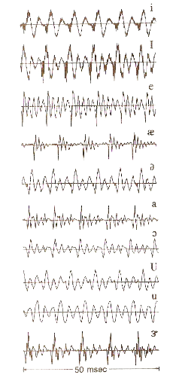

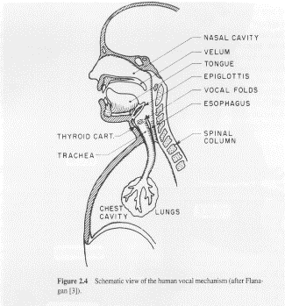
版權聲明
頁碼 | 作品 | 版權標示 | 作者 / 來源
2 |  |  | Lawrence Rabiner, Biing-Hwang Juang / FUNDAMENTALS OF SPEECH RECOGNITION Chap. 2, Sec. 2.4 Speech Sounds and Features, page 26, Prentice-Hall International, Inc.本作品依據著作權法第46、52、65條合理使用。
2 |  |  | 國立臺灣大學電機工程學系李琳山 教授。 本作品採用創用CC「姓名標示-非商業性-相同方式分享3.0臺灣」許可協議。
3, 38 |  |  | Lawrence Rabiner, Biing-Hwang Juang / FUNDAMENTALS OF SPEECH RECOGNITION Chap. 2, Sec. 2.3 Representing Speech in Time and Frequency Domains, page 16, Prentice-Hall International, Inc. 本作品依據著作權法第46、52、65條合理使用。
3, 38 |  |  | 國立臺灣大學電機工程學系李琳山 教授。 本作品採用創用CC「姓名標示-非商業性-相同方式分享3.0臺灣」許可協議。

Slide 52
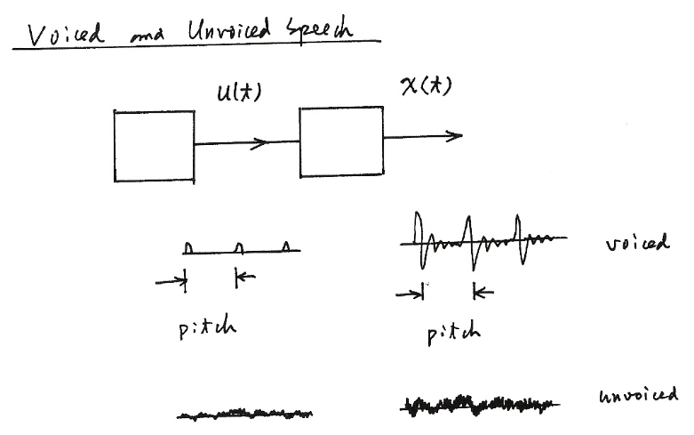
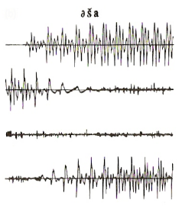
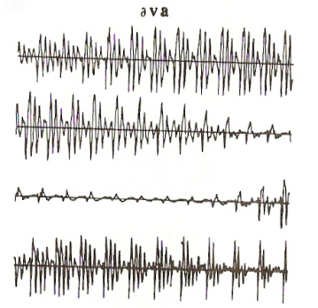
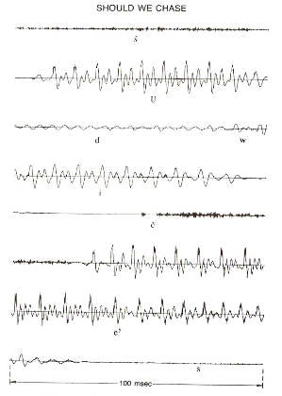
版權聲明
頁碼 | 作品 | 版權標示 | 作者 / 來源
4, 39 |  |  | 國立臺灣大學電機工程學系李琳山 教授。 本作品採用創用CC「姓名標示-非商業性-相同方式分享3.0臺灣」許可協議。
5 |  |  | Lawrence Rabiner, Biing-Hwang Juang / FUNDAMENTALS OF SPEECH RECOGNITION Chap. 2, Sec. 2.4 Speech Sounds and Features, page 35, Prentice-Hall International, Inc.本作品依據著作權法第46、52、65條合理使用。
5 |  |  | Lawrence Rabiner, Biing-Hwang Juang / FUNDAMENTALS OF SPEECH RECOGNITION Chap. 2, Sec. 2.4 Speech Sounds and Features, page 35, Prentice-Hall International, Inc.本作品依據著作權法第46、52、65條合理使用。
6, 24 |  |  | Lawrence Rabiner, Biing-Hwang Juang / FUNDAMENTALS OF SPEECH RECOGNITION Chap. 2, Sec. 2.4 Speech Sounds and Features, page 24, Prentice-Hall International, Inc.本作品依據著作權法第46、52、65條合理使用。

Slide 53

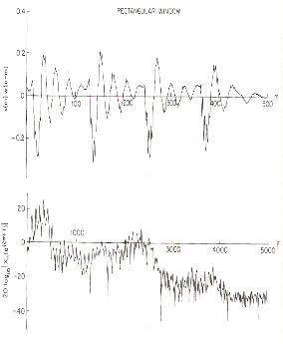
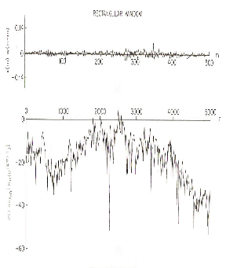
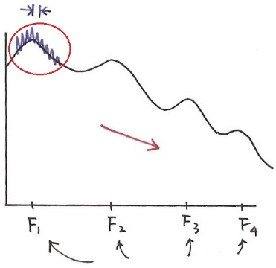
版權聲明
頁碼 | 作品 | 版權標示 | 作者 / 來源
7 |  |  | 國立臺灣大學電機工程學系李琳山 教授。 本作品採用創用CC「姓名標示-非商業性-相同方式分享3.0臺灣」許可協議。
8, 40 |  |  | Claudio Becchetti, Lucio Prina Ricotti / Speech Recognition: Theory and C++ Implementation, Wiley本作品依據著作權法第46、52、65條合理使用。
8, 40 |  |  | Claudio Becchetti, Lucio Prina Ricotti / Speech Recognition: Theory and C++ Implementation, Wiley本作品依據著作權法第46、52、65條合理使用。
9, 41 |  |  | 國立臺灣大學電機工程學系李琳山 教授。 本作品採用創用CC「姓名標示-非商業性-相同方式分享3.0臺灣」許可協議。

Slide 54
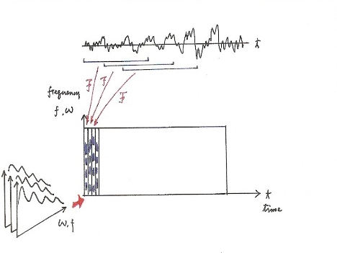
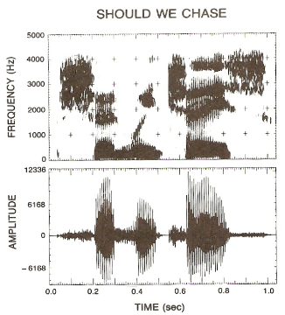
版權聲明
頁碼 | 作品 | 版權標示 | 作者 / 來源
9, 41 |  |  | 國立臺灣大學電機工程學系李琳山 教授。 本作品採用創用CC「姓名標示-非商業性-相同方式分享3.0臺灣」許可協議。
10, 27, 42 |  |  | 國立臺灣大學電機工程學系李琳山 教授。 本作品採用創用CC「姓名標示-非商業性-相同方式分享3.0臺灣」許可協議。
11 |  |  | 國立臺灣大學電機工程學系李琳山 教授。 本作品採用創用CC「姓名標示-非商業性-相同方式分享3.0臺灣」許可協議。
12 |  |  | Lawrence Rabiner, Biing-Hwang Juang / FUNDAMENTALS OF SPEECH RECOGNITION Chap. 2, Sec. 2.4 Speech Sounds and Features, page 22, Prentice-Hall International, Inc.本作品依據著作權法第46、52、65條合理使用。

Slide 55
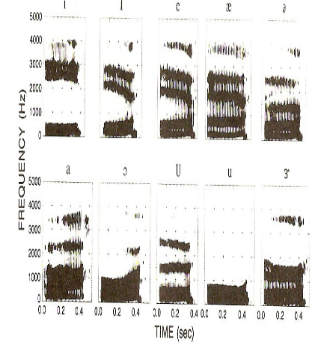
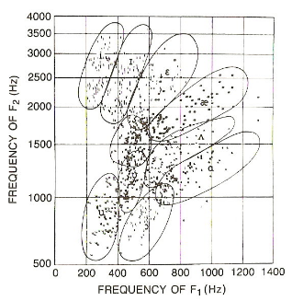

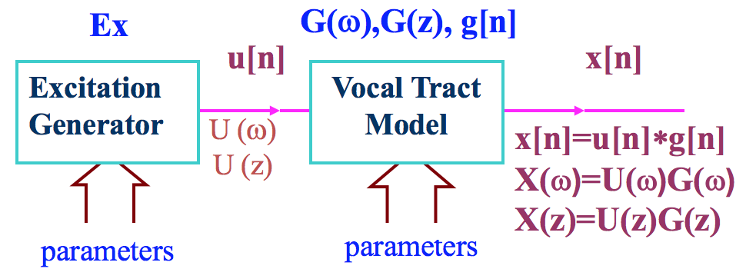
版權聲明
頁碼 | 作品 | 版權標示 | 作者 / 來源
13 |  |  | Lawrence Rabiner, Biing-Hwang Juang / FUNDAMENTALS OF SPEECH RECOGNITION Chap. 2, Sec. 2.4 Speech Sounds and Features, page 27, Prentice-Hall International, Inc.本作品依據著作權法第46、52、65條合理使用。
13 |  |  | Lawrence Rabiner, Biing-Hwang Juang / FUNDAMENTALS OF SPEECH RECOGNITION Chap. 2, Sec. 2.4 Speech Sounds and Features, page 27, Prentice-Hall International, Inc.本作品依據著作權法第46、52、65條合理使用。
14 |  |  | Xuedong Huang, Alex Acero, Hsiao-Wuen Hon / Spoken Language Processing: A Guide to Theory, Algorithm and System Development Chap. 6, Sec. 6.1, Prentice-Hall International, Inc.本作品依據著作權法第46、52、65條合理使用。
15 |  |  | 國立臺灣大學電機工程學系李琳山 教授。 本作品採用創用CC「姓名標示-非商業性-相同方式分享3.0臺灣」許可協議。

Slide 56




版權聲明
頁碼 | 作品 | 版權標示 | 作者 / 來源
16 |  |  | 國立臺灣大學電機工程學系李琳山 教授。 本作品採用創用CC「姓名標示-非商業性-相同方式分享3.0臺灣」許可協議。
17 |  |  | 國立臺灣大學電機工程學系李琳山 教授。 本作品採用創用CC「姓名標示-非商業性-相同方式分享3.0臺灣」許可協議。
17 |  |  | 國立臺灣大學電機工程學系李琳山 教授。 本作品採用創用CC「姓名標示-非商業性-相同方式分享3.0臺灣」許可協議。
18 |  |  | 國立臺灣大學電機工程學系李琳山 教授。 本作品採用創用CC「姓名標示-非商業性-相同方式分享3.0臺灣」許可協議。

Slide 57


版權聲明
頁碼 | 作品 | 版權標示 | 作者 / 來源
20, 34 |  |  | 國立臺灣大學電機工程學系李琳山 教授。 本作品採用創用CC「姓名標示-非商業性-相同方式分享3.0臺灣」許可協議。
21 |  |  | 國立臺灣大學電機工程學系李琳山 教授。 本作品採用創用CC「姓名標示-非商業性-相同方式分享3.0臺灣」許可協議。
21 |  |  | Claudio Becchetti, Lucio Prina Ricotti / Speech Recognition: Theory and C++ Implementation, Wiley本作品依據著作權法第46、52、65條合理使用。
25 |  |  | 國立臺灣大學電機工程學系李琳山 教授。 本作品採用創用CC「姓名標示-非商業性-相同方式分享3.0臺灣」許可協議。

Slide 58


版權聲明
頁碼 | 作品 | 版權標示 | 作者 / 來源
26 |  |  | Claudio Becchetti, Lucio Prina Ricotti / Speech Recognition: Theory and C++ Implementation, Wiley本作品依據著作權法第46、52、65條合理使用。
28 |  |  | 國立臺灣大學電機工程學系李琳山 教授。 本作品採用創用CC「姓名標示-非商業性-相同方式分享3.0臺灣」許可協議。
30 |  |  | 國立臺灣大學電機工程學系李琳山 教授。 本作品採用創用CC「姓名標示-非商業性-相同方式分享3.0臺灣」許可協議。
31 |  |  | Carolina Ear Care and Hearing Aid Center/ http://www.carolinaearcare.com/page3.html本作品依據著作權法第46、52、65條合理使用。

Slide 59

版權聲明
頁碼 | 作品 | 版權標示 | 作者 / 來源
31 |  |  | Encyclopædia Britannica, Inc. / https://global.britannica.com/topic/Encyclopaedia-Britannica-English-language-reference-work本作品依據著作權法第46、52、65條合理使用。
32 |  |  | 國立臺灣大學電機工程學系李琳山 教授。 本作品採用創用CC「姓名標示-非商業性-相同方式分享3.0臺灣」許可協議。
33 |  |  | 國立臺灣大學電機工程學系李琳山 教授。 本作品採用創用CC「姓名標示-非商業性-相同方式分享3.0臺灣」許可協議。
33 |  |  | 國立臺灣大學電機工程學系李琳山 教授。 本作品採用創用CC「姓名標示-非商業性-相同方式分享3.0臺灣」許可協議。

Slide 60




版權聲明
頁碼 | 作品 | 版權標示 | 作者 / 來源
35 |  |  | 國立臺灣大學電機工程學系李琳山 教授。 本作品採用創用CC「姓名標示-非商業性-相同方式分享3.0臺灣」許可協議。
43 |  |  | 國立臺灣大學電機工程學系李琳山 教授。 本作品採用創用CC「姓名標示-非商業性-相同方式分享3.0臺灣」許可協議。
44 |  |  | 國立臺灣大學電機工程學系李琳山 教授。 本作品採用創用CC「姓名標示-非商業性-相同方式分享3.0臺灣」許可協議。
45 |  |  | 國立臺灣大學電機工程學系李琳山 教授。 本作品採用創用CC「姓名標示-非商業性-相同方式分享3.0臺灣」許可協議。

Slide 61


版權聲明
頁碼 | 作品 | 版權標示 | 作者 / 來源
47 |  |  | 國立臺灣大學電機工程學系李琳山 教授。 本作品採用創用CC「姓名標示-非商業性-相同方式分享3.0臺灣」許可協議。
48 |  |  | 國立臺灣大學電機工程學系李琳山 教授。 本作品採用創用CC「姓名標示-非商業性-相同方式分享3.0臺灣」許可協議。
49 |  |  | 國立臺灣大學電機工程學系李琳山 教授。 本作品採用創用CC「姓名標示-非商業性-相同方式分享3.0臺灣」許可協議。

